Slide 1
Student Data and Record Management
Name: V. Shiva Venkata Sai
Roll No: 2520090092
Department: CSIT
Under the Guidance of
Supervisor Name: G.Mamatha
Assistant Professor
Department of CSE

Slide 2
Abstract
• Java based student management application
• Manages student data efficiently
• Supports add, search, delete and sorting
• Demonstrates Data Structures & Algorithms
• Uses Linked Lists, Queues, Hash Tables and Sorting

Slide 3
Existing System
• Manual student record maintenance
• Records stored in papers or spreadsheets
• Difficult to search student details
• Data redundancy and errors possible
• Time consuming record management

Slide 4
Proposed System
• Java console based application
• Stores student information digitally
• Supports efficient search and sort
• Uses advanced data structures
• Improves performance and organization

Slide 5
System Architecture
• User interacts with console interface
• Java program processes student data
• Data stored using ArrayList
• Algorithms perform search and sorting
• Hash tables enable fast lookup

Slide 6
Project Modules
• Login Module
• Student Management Module
• Searching Module
• Sorting Module
• Linked List Module
• Queue Operations Module
• Hashing Module
• Complexity Analysis

Slide 7
Objectives
• Implement student record management system
• Apply data structures in real application
• Practice Java collections framework
• Compare searching and sorting algorithms
• Improve data handling efficiency

Slide 8
CO Attainments
CO1 – Algorithm Analysis
Implement Linear Search and Binary Search
Implement Sorting Algorithms (Bubble, Selection, Insertion, Merge, Quick)
Analyze algorithm efficiency using Big-O notation

Slide 9
CO Attainments
CO2 – Abstract Data Types
Implement Arrays and Linked Lists
Implement Singly, Doubly and Circular Linked Lists
Perform operations Insert, Delete, Search, Traverse, Reverse

Slide 10
CO Attainments
CO3 – Stacks and Queues
Implement Stack ADT and Queue ADT
Use Circular Queue and Deque
Implement Priority Queue using Heap

Slide 11
CO Attainments
CO4 – Hash Based Data Structures
Implement Hash Tables
Use Separate Chaining and Open Addressing
Apply Java Collections Framework (List, Queue, Map)

Slide 12
CO Attainments
CO5 – Applications of Linear Data Structures
Develop Student Record Management System
Use Arrays, Linked Lists, Stacks and Queues
Perform Add, Search, Delete, Display operations

Slide 13
CO Attainments
CO6 – Skill Development
Improve problem solving skills
Develop efficient algorithms
Build DSA based programs in Java

Slide 14
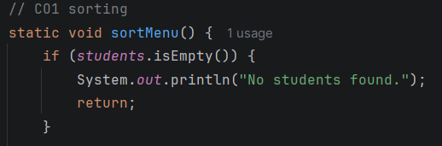
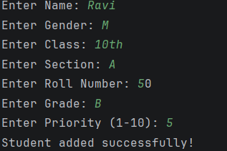
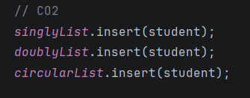
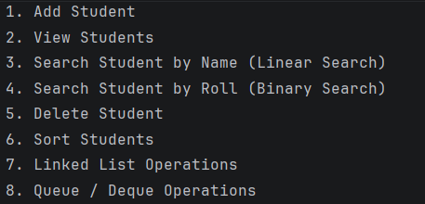
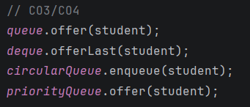
ScreenShots:

Slide 15
Conclusion
• Demonstrates real use of data structures
• Combines multiple algorithms in one system
• Improves understanding of algorithm efficiency
• Can be extended with GUI and database
• Useful learning project for DSA

Slide 16
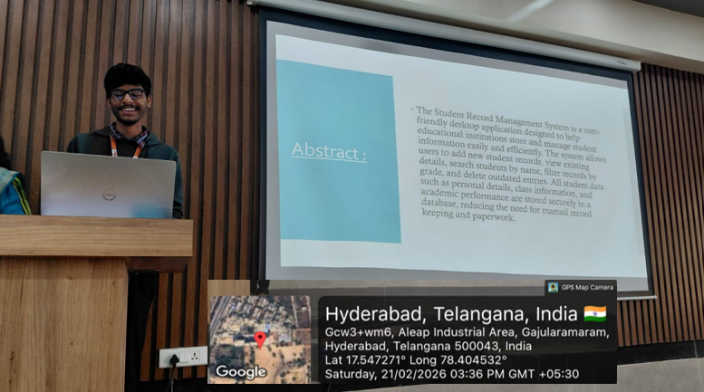
Geo-Taged Photo

Slide 17
Thank You

